Slide 1



Dia Mundial da Água
World Water Day
22 de março
22nd of March

Slide 2

Clean Water and Sanitation
Sustainable Development Goal (SDG) 6
1. Back in 2015, the world committed to as part of the 2030 Agenda – the promise that everyone would have safely managed water and sanitation by 2030.
2.The UN 2023 Water Conference, 22-24 March, is a once-in-a-generation opportunity to unite the world around solving the water and sanitation crisis.
This Conference will launch the Water Action Agenda, which will include commitments from people around the world.

Slide 3
Water Posters
We are also committed to saving water.
To raise awareness students draw the following posters which where exhibited at school.

Slide 4
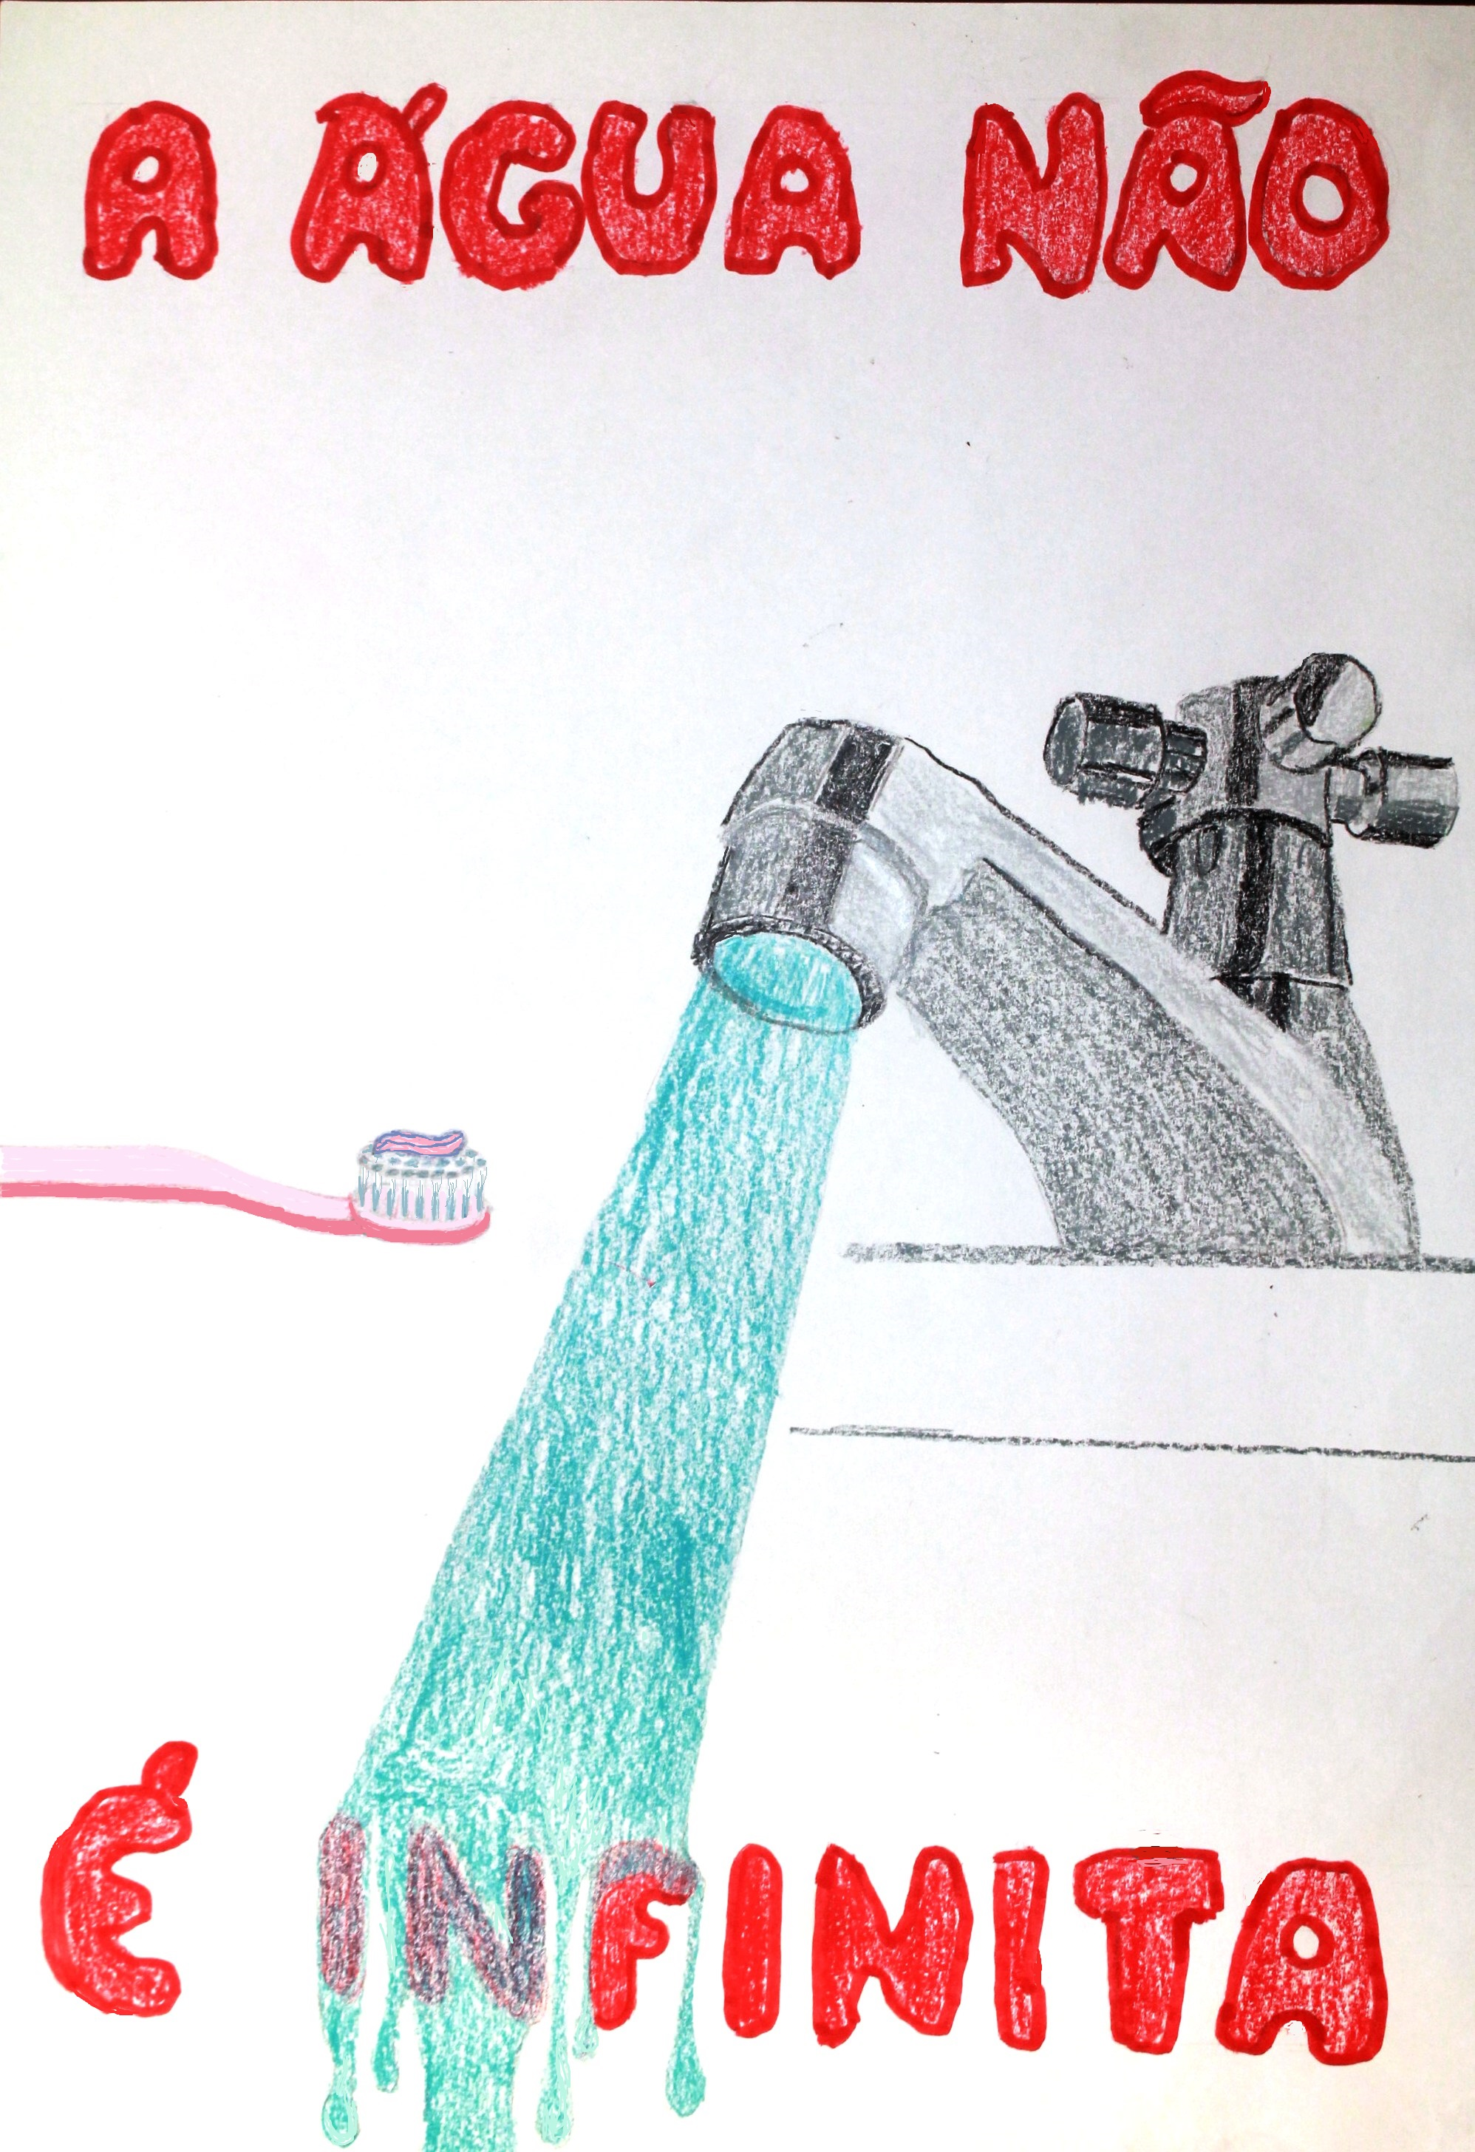


Slide 5
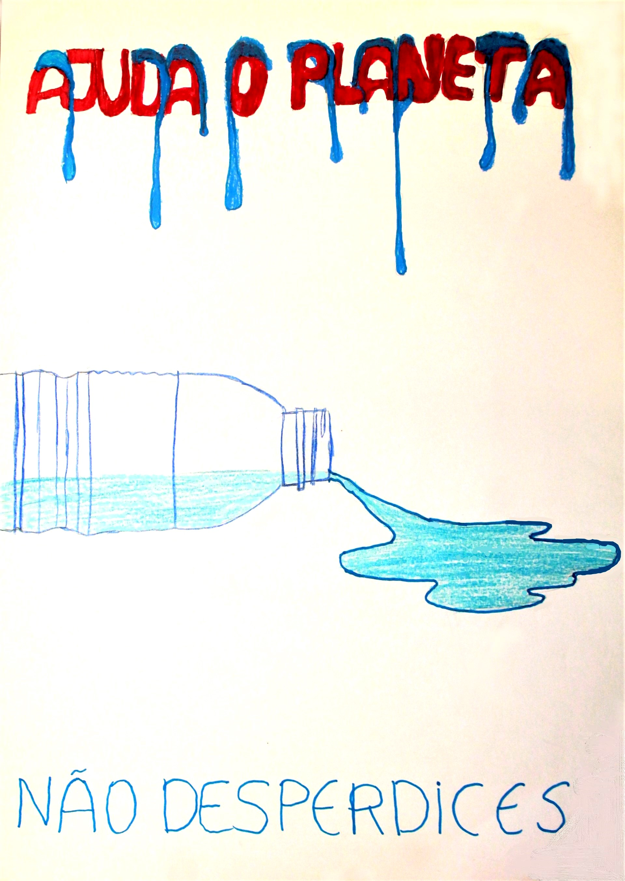
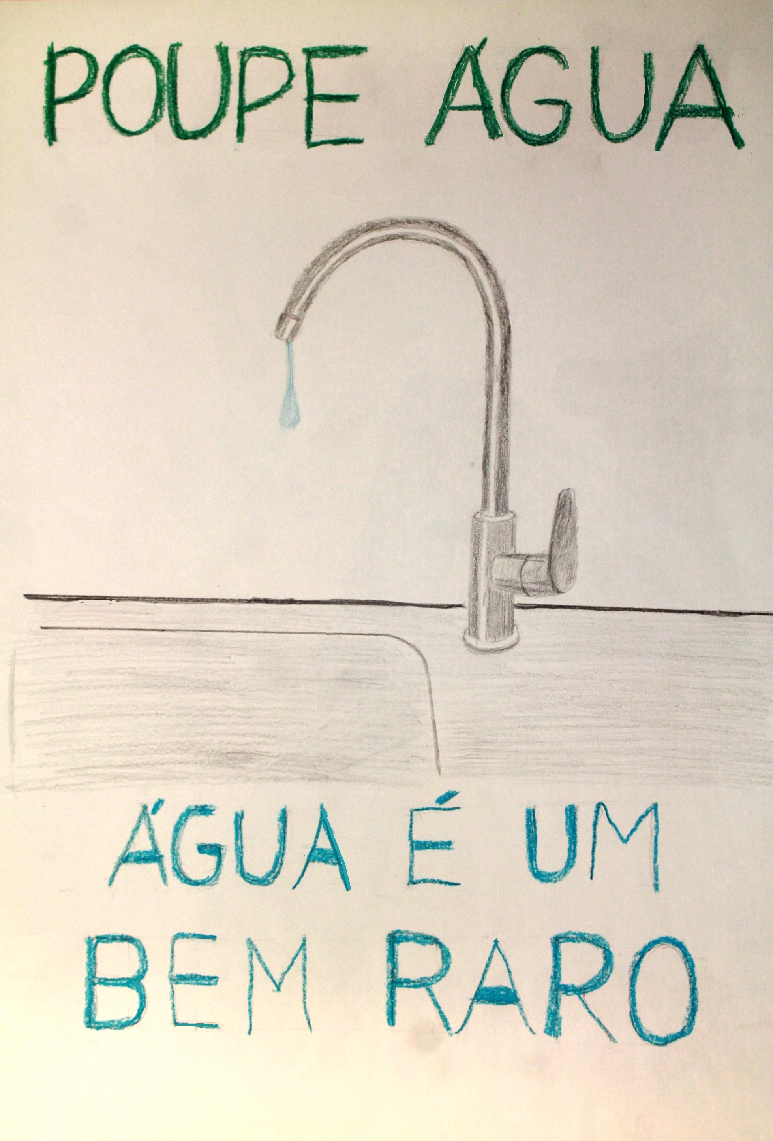

Slide 6
