Slide 1






MEMORY GAME
2023

Slide 2
Memory Game
This activity was carried out by students with special educational needs. The given topic was “ecology and sustainability”, especially the local environmental preservation.
After analysing various hypotheses to raise awareness among the school population, the students have com to the conclusion that the protection of the local beach dunes is very important to preserve the environmental heritage of the nearby beaches, a fact that is not always known by people. Thus, the students chose to create a memory game as a way to raise awareness in a playful way, which is a very effective with children and teenagers.
The objective was to sensitise students in particular and the educational community in general to the protection of coastal areas, in particular the dunes and their “habitat”. The dunes play an important role in protecting coastal areas, buildings and agricultural crops from the effect of storms and winds and in fixing the sand on the coast, in addition to being important to many species of fauna and flora that enrich the natural heritage of the coast.
The students began to do a research work on dunes and local species. They wrote the game´s instruction and a list of environmentally friendly behaviours to be followed. After that they took pictures at the seaside, which were scanned, tagged and placed in an image grid and then printed. The printouts were then cut, glued and laminated resulting in this memory game cards.
The game is available in the school's library to be used by the educational community.

Slide 3
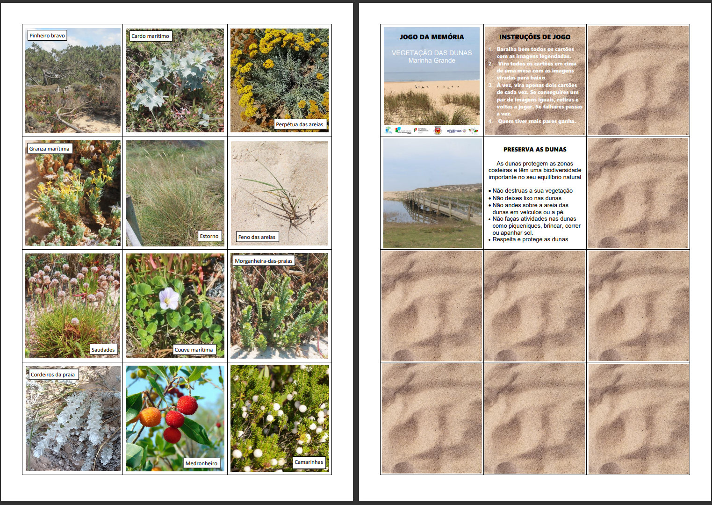

Slide 4
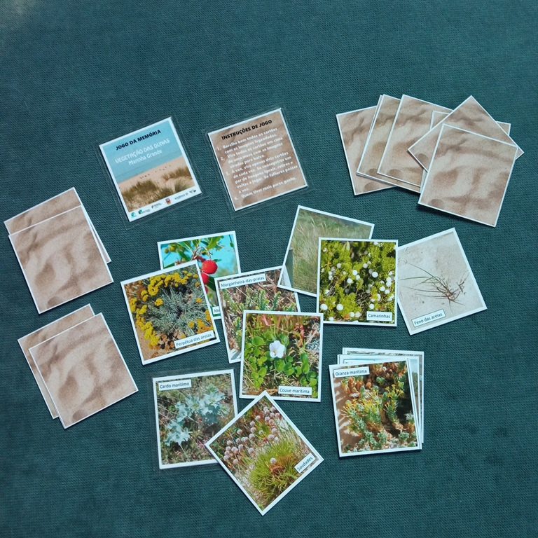
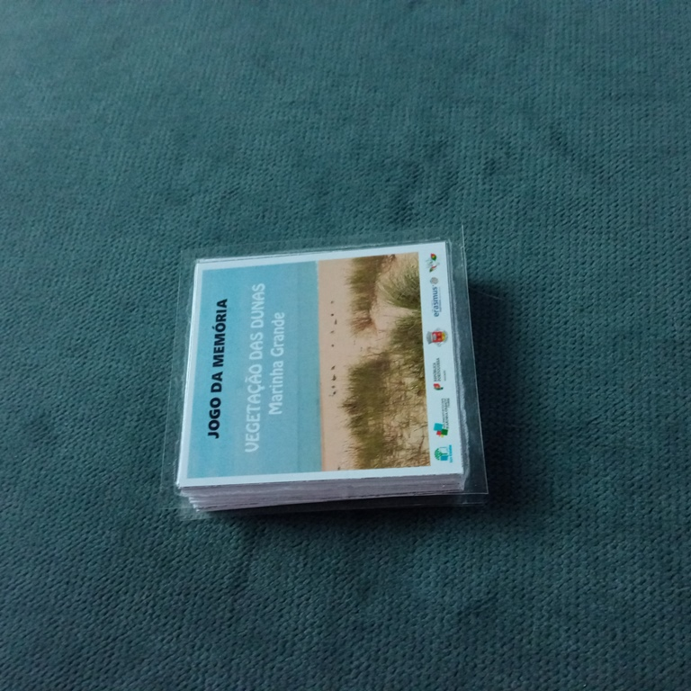

Slide 5
