Slide 1
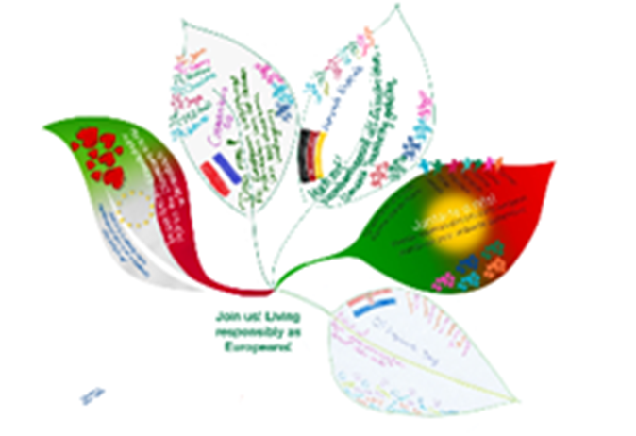





Horta Biológica
2021/2022

Slide 2
Organic Farming ─ Vegetable Garden
A school vegetable garden makes lasting differences in the lives of pupils. That why the projects „Join us“ and „Eco-Schools“ thought about growing a vegetable garden which actively involves pupils. A school garden uses gardening tasks, such as planning, planting, caring and harvesting, to illustrate cultivation. Plants, insects, birds and weather all become participants in the learning process. It´s an hands-on-learning. Considering these tasks pupils with special educational needs were included to care for the garden.
At first pupils planted and sowed only aromatic herbs such as parsley, coriander, mint, savory, mint, fennel and frankincense. But they quickly introduced strawberries, leeks, lettuce, and more recently tomatoes, peppers, courgettes and cabbage.
Some products are sold at school and others are used in our pedagogical kitchen to be used as ingredients.

Slide 3
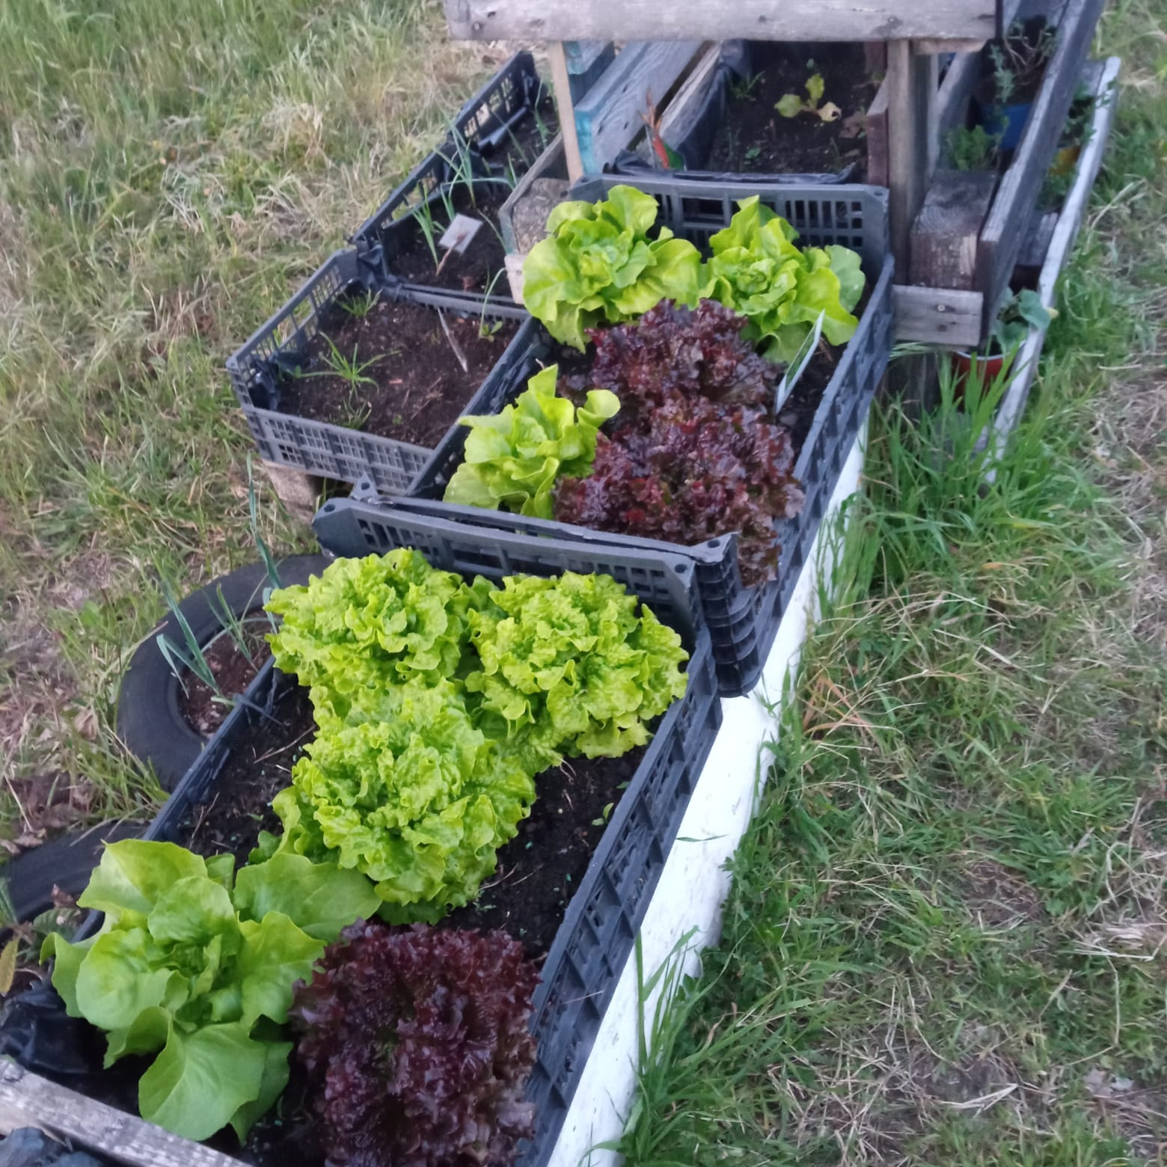
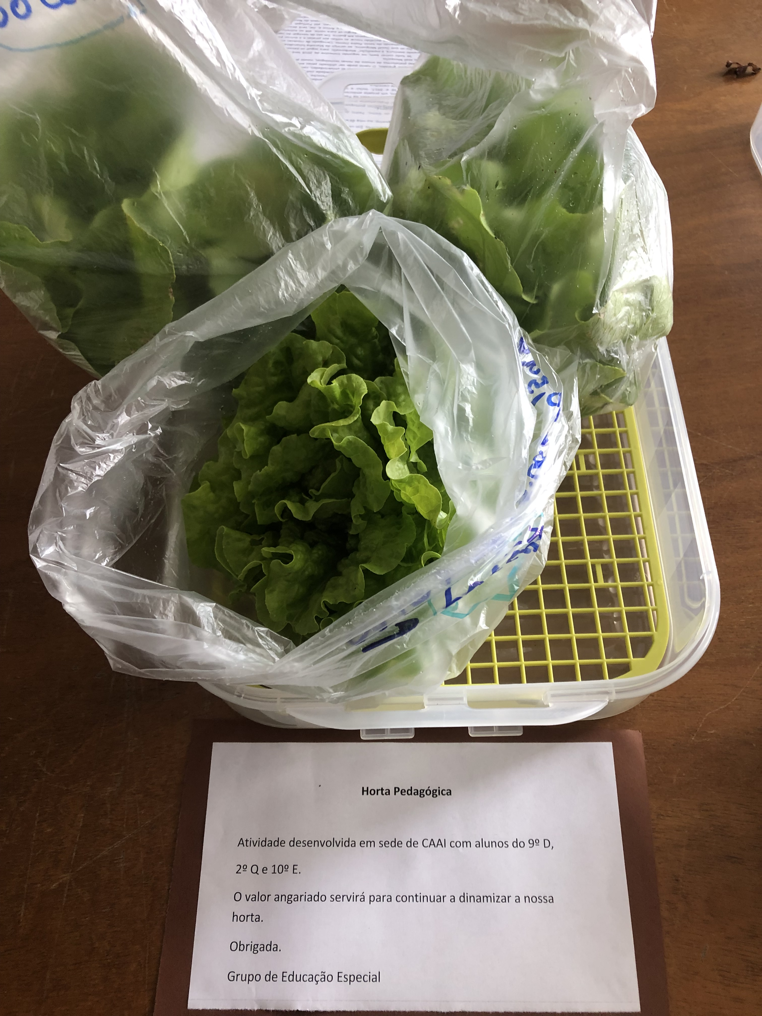
Alface vendida na sala de professores
Lettuce sold in the teachers´staffroom

Slide 4
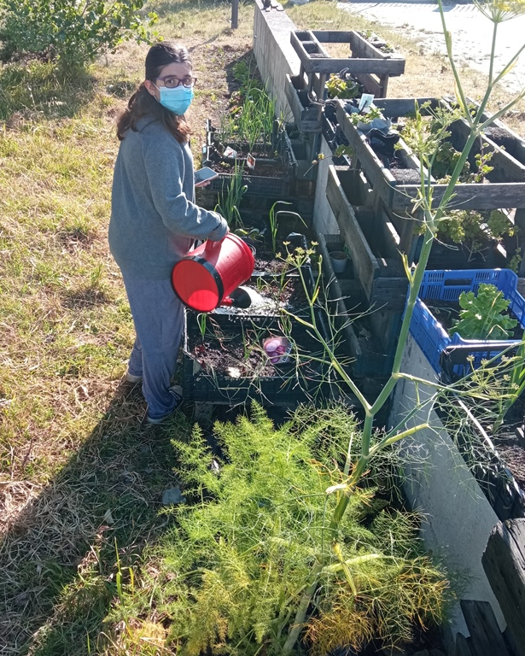
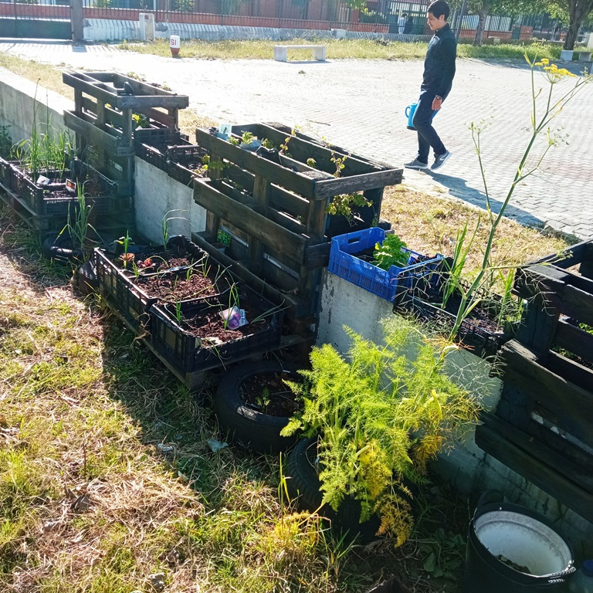
A Horta, construída com paletes tratadas, nasceu apoiada num muro do recreio para evitar que gatos e cães estragassem os produtos cultivados.

Slide 5
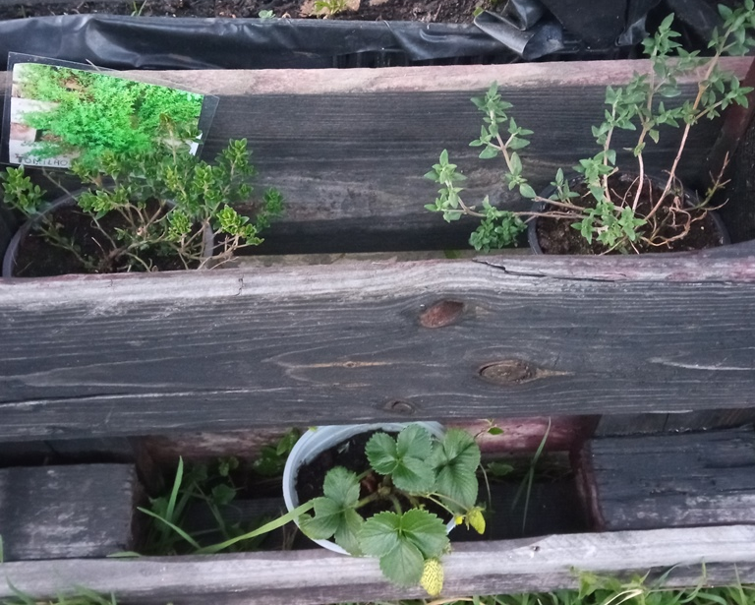
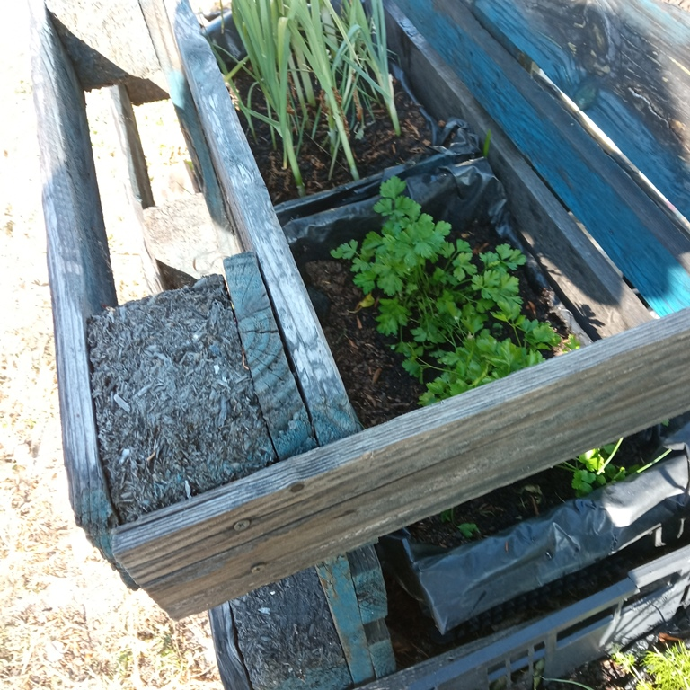
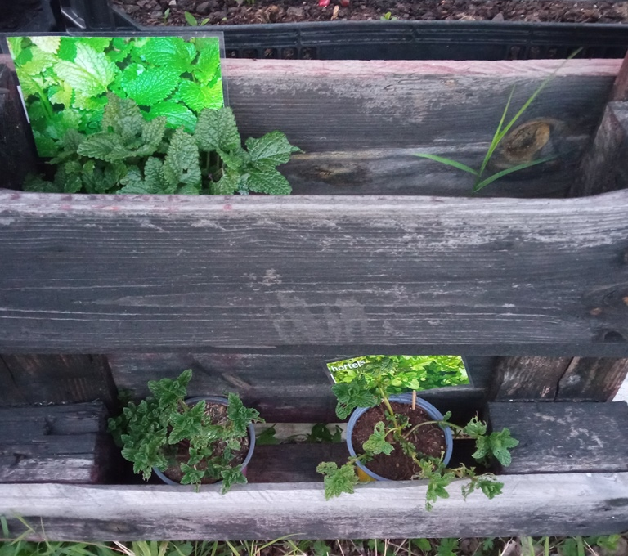
De início plantaram e semearam na horta apenas ervas aromáticas como salsa, coentros, menta, segurelha, hortelã, funcho e incenso.
Mas rapidamente introduziram também morangos, alho francês, alfaces, e mais recentemente tomate, pimento, courgette e couve.
Alguns produtos foram vendidos na escola e outros foram entregues à cozinha pedagógica para serem usados como ingredientes.

Slide 6
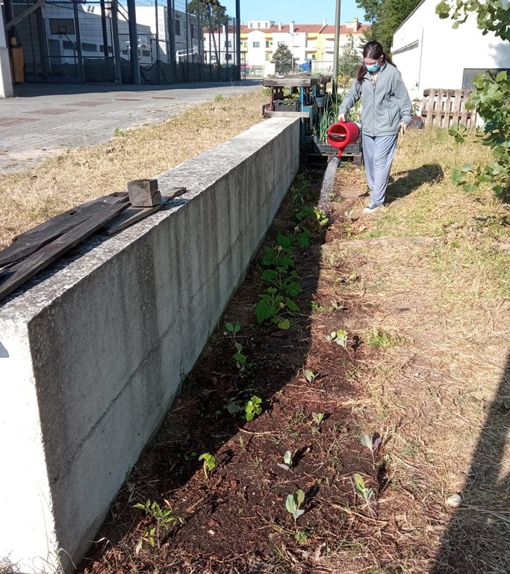
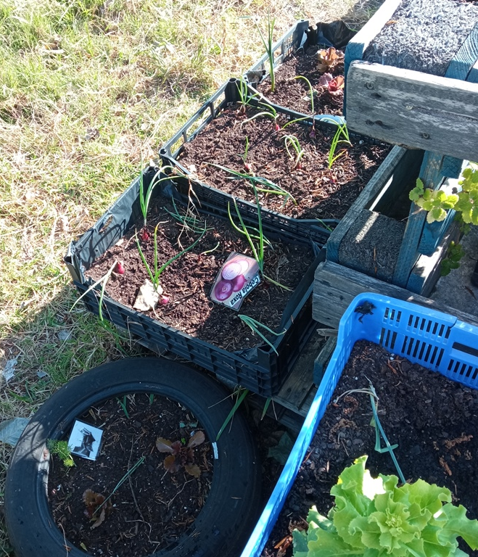
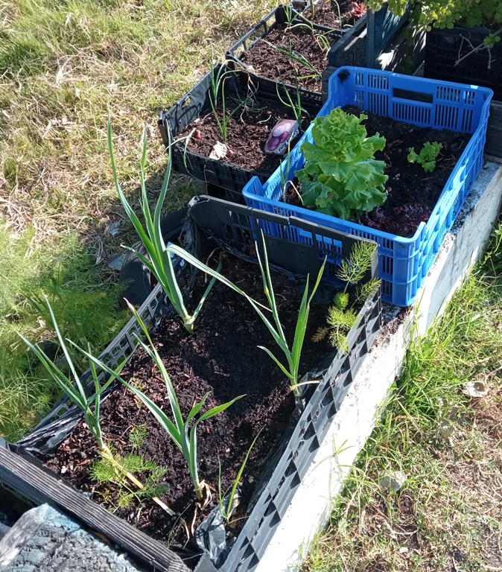
Os alunos regam e cuidam da horta pelo menos duas vezes por semana com a supervisão de uma professora

